Slide 1
Agenda
Review Quiz 1
Business Ethics
Ethical Dilemmas
Behavioral Ethics
Before Next Class

Slide 2
Key Concepts
Ethical Dilemma
Business Case
Business Model
Competitive Advantage
Stakeholder
Shareholder
Stakeholder Theory
Globalization
Corporate Social Responsibility (CSR) / Sustainability
©Cathy Moran, 2018
Notes:
Business Case: The argument for doing something; business case vs. business model: why do it vs how to do it. A business case captures the reasoning for initiating a project or task.
Business Model: A term used to represent core aspects of a business, including purpose, target customers (e.g., consumers or other businesses), product/service offerings, strategies, organizational structures, trading practices, distribution model (e.g., direct sales, wholesale, retail) and operational processes and policies.
Competitive Advantage: The edge a company has over its rivals that allows it to generate greater sales or profit margins or to retain more customers than its competition.
Stakeholder: A person, group, organization, or system who affects or can be affected by an organization's actions
Shareholder: Any person, company or other institution that owns at least one share of a company’s stock. Shareholders are a company's owners. They have the potential to profit if the company does well, but that comes with the potential to lose money if the company does poorly. A shareholder may also be referred to as a stockholder.
Stakeholder Theory: The business entity should be used as a vehicle for coordinating stakeholder interests instead of maximizing shareholder (owner) profit. Stakeholder Theory says the business should consider the interests of all stakeholders and optimize profit with these considerations in mind. Shareholder profit is still very important however it is not the only thing that’s important. Stakeholder Theory is contradictory to Milton Friedman’s thinking that the goal of business must be to maximize profit and that business should not be concerned with anything other than this.
Globalization: The increasingly worldwide relationships of culture, people and economic activity. Most often, it refers to economics: the global distribution of the production of goods and services, through reduction of barriers to international trade such as tariffs, export fees, import quotas, etc.. The term can also refer to the transnational circulation of ideas, languages, and popular culture.
Corporate Social Responsibility / Sustainability: “continuing commitment by business to behave ethically and contribute to economic development while improving the quality of life in the workforce and their families as well as of the local community and society at large” (source: World Business Council on Sustainable Development, http://www.wbcsd.org).

Slide 3
ETHICAL DILEMMA
Notes:
Teaching of business ethics, especially in MBA programs, is criticized.
- Students already understand right & wrong. (AGREE?) Nothing to teach there.
- Objective: make sound judgments
- First challenge is to recognize an ethical dilemma as such.

Slide 4
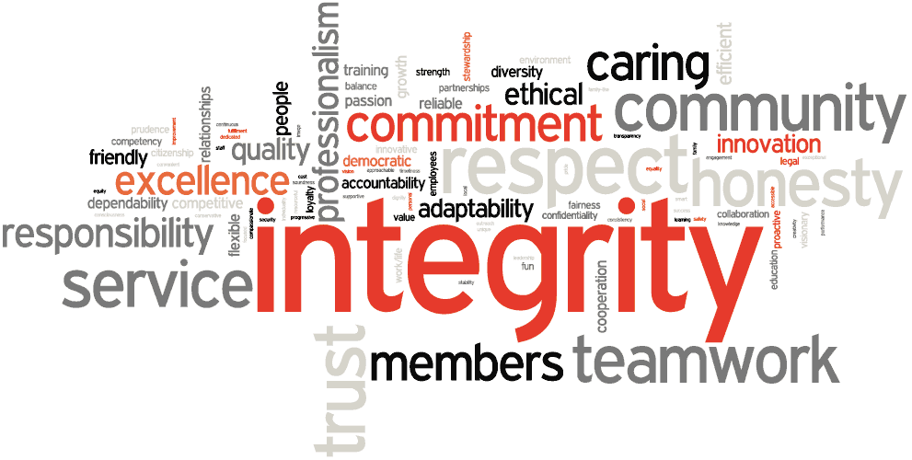
Notes:
Core values: guiding principles that dictate behavior and action. The ideals and principles that guide how people act.
Core values can help people to know what is right from wrong; they can help companies to determine if they are on the right path and fulfilling their business goals; and they create an unwavering and unchanging guide.
Differ from person to person, company to company.

Slide 5
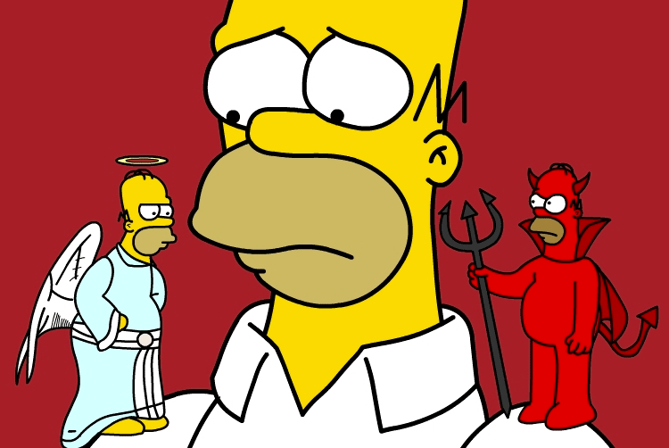
Notes:
Moral Temptations vs. Ethical Dilemmas
Kidder (1995) contends that an ethical dilemma occurs only when there are competing “rights”
or there is a struggle to determine the “least bad” course of action.

Slide 6
Ethical Dilemma
When two of our “most profound and central values” are in conflict but both are “right” to uphold¹
  Values such as
    Honesty
    Compassion
    Fairness
    Responsibility
    Respect…
¹Rushworth M. Kidder, How Good People Make Tough Choices (New York: Harper, 2003), pg. 5

Slide 7
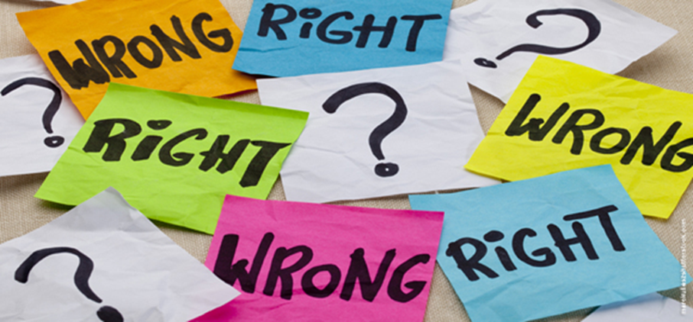
Moral Temptations versus Ethical Dilemmas
MORAL TEMPTATION: choosing to do something we know is wrong
(right vs. wrong)
ETHICAL DILEMMA: having to choose between two rights (right vs. right)
Notes:
Moral temptation or ethical dilemma?
Testing for Right vs. Right
When a situation passes all of the right vs. wrong tests
Determine “what sort of dilemma is this?”
Benefits of determining which dilemma:
Reduces complexity into a manageable problem
Gets to the “heart of the matter”
Acts as a second test of an ethical temptation
To test whether a scenario is a right vs. right dilemma and if so, which one, you apply each paradigm to the scenario to find the “best fit”

Slide 8
Ethical Dilemma
a situation in which there is a choice to be made between two options, neither of which resolves the situation in a morally acceptable fashion
Notes:
A situation that often involves an apparent mental conflict between moral imperatives, in which to obey one would result in transgressing another
“Morally acceptable" is subjective. Two people can disagree on whether something is morally acceptable.
Most people would agree that breaking the law is morally wrong. But what if your friend is having a heart attack while you're driving together somewhere?
It would be illegal (morally wrong) to exceed the speed limit, but morally right (but illegal) to speed him to the nearest hospital.
One can argue that speeding, although wrong, may result in a better outcome than driving the speed limit or pulling over and calling an ambulance.
Here's the bottom line: You should be able to distinguish an ethical dilemma from a moral temptation. A moral temptation is a "wrong" act. We humans are extremely good at rationalizing to convince ourselves that a moral temptation is an ethical dilemma. That way, we get to take the easy way out by pursuing the moral temptation by claiming it's an ethical dilemma when it isn't.

Slide 9
Moral Temptations vs. Ethical Dilemmas
right versus right = ethical dilemma
right versus wrong = moral temptation
right versus wrong ≠ ethics
Notes:
Moral temptation or ethical dilemma?
Testing for Right vs. Right
When a situation passes all of the right vs. wrong tests
Determine “what sort of dilemma is this?”
Benefits of determining which dilemma:
Reduces complexity into a manageable problem
Gets to the “heart of the matter”
Acts as a second test of an ethical temptation
To test whether a scenario is a right vs. right dilemma and if so, which one, you apply each paradigm to the scenario to find the “best fit”

Slide 10

When two of our “most profound values” are in conflict but both are “right” to uphold¹
a Right vs. Right choice to make
Notes:
Ethical dilemmas require difficult decisions. What makes these decisions hard, according to Kidder, is that they are often choices of “right” vs. “right.”
In the example from the last slide,…
Right vs. Right describes the two different options you have as the driver, neither of which neither of which resolves the situation in an morally acceptable fashion. One option is to obey the law, but your friend could die as a result. The other option is to break the law, which is wrong but you might feel a moral obligation to do everything you can - including break the law - to save your friend.
Examples:
- Need time to study more for an exam: It is right to go to my MGT 166 class today and it is right to do everything I can to do well on my engineering midterm.
- It is right to tell the my boss that I’m covering for my coworker when he has to leave early, but it is also right to be loyal to my coworker (Truth vs. Loyalty)
- It is right for an engineer to be disciplined for misconduct, but it is also right to show compassion for human error. (Justice vs. Mercy)
Force yourself to talk about them in terms of a RIGHT vs. a RIGHT. Otherwise, you can easily disguise a moral temptation as an ethical dilemma

Slide 11

The trolley dilemma:
Would you kill one person to save five?
Notes:
You are a head engineer for a municipal trolley system and you see that a runaway trolley is hurtling down the tracks towards five railway workers who will be killed if it proceeds on its present course. The only way to save these people is to hit a switch that will turn the trolley onto a side track where it will run over and kill one worker instead of five.
So, would you hit the switch, leading to one death but saving five?
This is the now classic thought experiment known as the trolley dilemma, developed by philosopher Philippa Foot in 1967.
The trolley dilemma allows us to think through the consequences of an action and consider whether its moral value is determined solely by its outcome.

Slide 12
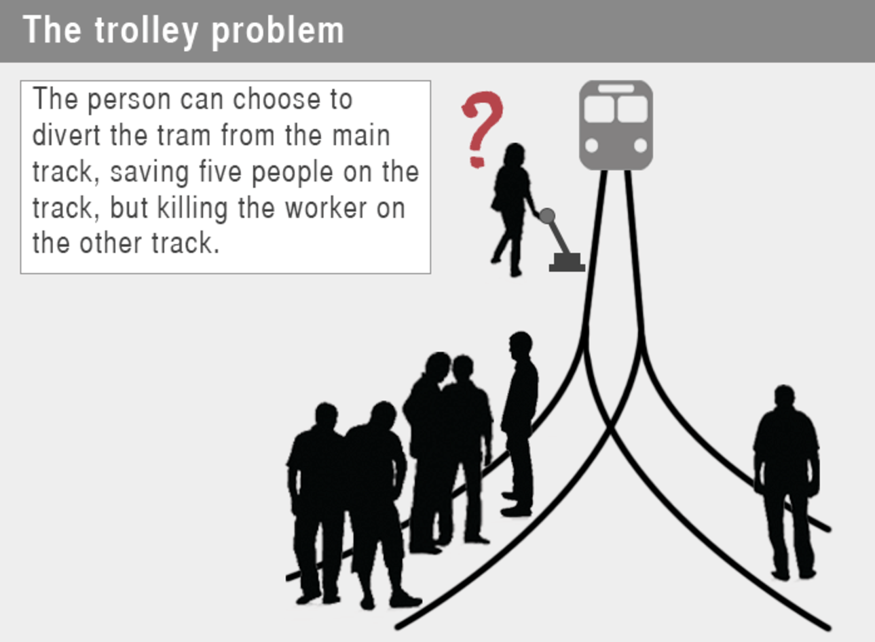
Do you choose to divert the trolley from the main track, saving five workers but killing one?

Slide 13

4 Dilemma Paradigms
Truth vs. Loyalty
Justice vs. Mercy
Individual vs. Community
Short Term vs. Long Term
Notes:
These four basic paradigms can be useful for analyzing ethical choices and realizing what has created the conflict.
If you have a better understanding of a choice, then you should be better prepared to solve it.
How is understanding the type of dilemma helpful?
-It helps us separate right from wrong;
-It helps us cut through mystery, complexity, and confusion;
-it helps us strip away extraneous detail and get to the heart of the matter.
------------------------------------------------
Kidder’s Four Paradigms for Understanding Ethical Dilemmas:
1. Truth vs. Loyalty: Truth, for most people, is conformity with facts or reality. Loyalty involves allegiance to a person, corporation or body of people, a government, or set of ideas to which one owes fidelity. It is right to stand on truth. It is right to be loyal. (e.g., sports – saw teammate cheat)
2. Individual vs. Community: Individualism assumes that in a society where each person vigorously pursues his own interests, the social good would automatically emerge. As such, the rights of the individual are to be preserved. By “community” it is meant that the needs of the majority outweigh the interests of the individual. Communities speak to us in a moral voice. They lay claims on their members. It is right to consider the individual. It is right to consider the community. (e.g., trolley)
3. Short-Term vs. Long-Term: Short-term concerns are usually associated with the satisfaction of current needs in such a way as to preserve the possibility of a future. Long-term concerns are usually defined by the projection of future interests in such a way that there will be ample means to meet future required needs. It is right to think and plan short-term. It is right to think and plan long-term. (e.g., cheat in college; unprepared for job)
4. Justice vs. Mercy: Justice urges us to stick by our principles, hold to the rules despite the pressures of the moment, and pursue fairness without attention to personalities or situations. Mercy urges us to care for the peculiar needs so individuals case by case and to seek benevolence in every way possible. It is right to be merciful. It is right to enforce justice. (e.g., a mistake made. Not illegal, but in error.)
---------------------------------------------------------------
Source: Rushworth M. Kidder, How Good People Make Tough Choices (New York: Harper, 2003)

Slide 14
Dilemma Paradigm: Truth versus Loyalty
WRONG: “I don’t want to lie to my boss but it is right to be loyal to my coworker”
RIGHT: “It is right to tell the truth to my boss, but it is also right to be loyal to my coworker”
It is right to stand on truth. It is right to be loyal.
Notes:
1. Truth vs. Loyalty: Truth, for most people, is conformity with facts or reality. Loyalty involves allegiance to a person, corporation or body of people, a government, or set of ideas to which one owes fidelity. It is right to stand on truth. It is right to be loyal. (e.g., sports – saw teammate cheat)
2. Individual vs. Community: Individualism assumes that in a society where each person vigorously pursues his own interests, the social good would automatically emerge. As such, the rights of the individual are to be preserved. By “community” it is meant that the needs of the majority outweigh the interests of the individual. Communities speak to us in a moral voice. They lay claims on their members. It is right to consider the individual. It is right to consider the community. (e.g., trolley)
3. Short-Term vs. Long-Term: Short-term concerns are usually associated with the satisfaction of current needs in such a way as to preserve the possibility of a future. Long-term concerns are usually defined by the projection of future interests in such a way that there will be ample means to meet future required needs. It is right to think and plan short-term. It is right to think and plan long-term. (e.g., cheat in college; unprepared for job)
4. Justice vs. Mercy: Justice urges us to stick by our principles, hold to the rules despite the pressures of the moment, and pursue fairness without attention to personalities or situations. Mercy urges us to care for the peculiar needs so individuals case by case and to seek benevolence in every way possible. It is right to be merciful. It is right to enforce justice. (e.g., a mistake made. Not illegal, but in error.)
How is understanding the type of dilemma helpful?
-It helps us separate right from wrong;
-It helps us cut through mystery, complexity, and confusion;
-it helps us strip away extraneous detail and get to the heart of the matter.
---------------------------------------------------------------
Source: Rushworth M. Kidder, How Good People Make Tough Choices (New York: Harper, 2003)

Slide 15
Dilemma Paradigm: Justice versus Mercy
WRONG: “It’s not right for an engineer to sign off on a project he didn’t inspect, but it’s also right for us to forgive her for that one mistake”
RIGHT: “It is right for an engineer to be sanctioned for misconduct, but it is also right to show compassion for human error”
It is right to be merciful. It is right to enforce justice.
Notes:
1. Truth vs. Loyalty: Truth, for most people, is conformity with facts or reality. Loyalty involves allegiance to a person, corporation or body of people, a government, or set of ideas to which one owes fidelity. It is right to stand on truth. It is right to be loyal. (e.g., sports – saw teammate cheat)
2. Individual vs. Community: Individualism assumes that in a society where each person vigorously pursues his own interests, the social good would automatically emerge. As such, the rights of the individual are to be preserved. By “community” it is meant that the needs of the majority outweigh the interests of the individual. Communities speak to us in a moral voice. They lay claims on their members. It is right to consider the individual. It is right to consider the community. (e.g., trolley)
3. Short-Term vs. Long-Term: Short-term concerns are usually associated with the satisfaction of current needs in such a way as to preserve the possibility of a future. Long-term concerns are usually defined by the projection of future interests in such a way that there will be ample means to meet future required needs. It is right to think and plan short-term. It is right to think and plan long-term. (e.g., cheat in college; unprepared for job)
4. Justice vs. Mercy: Justice urges us to stick by our principles, hold to the rules despite the pressures of the moment, and pursue fairness without attention to personalities or situations. Mercy urges us to care for the peculiar needs so individuals case by case and to seek benevolence in every way possible. It is right to be merciful. It is right to enforce justice. (e.g., a mistake made. Not illegal, but in error.)
How is understanding the type of dilemma helpful?
-It helps us separate right from wrong;
-It helps us cut through mystery, complexity, and confusion;
-it helps us strip away extraneous detail and get to the heart of the matter.
---------------------------------------------------------------
Source: Rushworth M. Kidder, How Good People Make Tough Choices (New York: Harper, 2003)

Slide 16
Dilemma Paradigm: Individual versus Community
WRONG: “It’s not right…
RIGHT: “It is right for…
It is right to consider the individual. It is right to consider the community. (e.g., trolley)
Notes:
1. Truth vs. Loyalty: Truth, for most people, is conformity with facts or reality. Loyalty involves allegiance to a person, corporation or body of people, a government, or set of ideas to which one owes fidelity. It is right to stand on truth. It is right to be loyal. (e.g., sports – saw teammate cheat)
2. Individual vs. Community: Individualism assumes that in a society where each person vigorously pursues his own interests, the social good would automatically emerge. As such, the rights of the individual are to be preserved. By “community” it is meant that the needs of the majority outweigh the interests of the individual. Communities speak to us in a moral voice. They lay claims on their members. It is right to consider the individual. It is right to consider the community. (e.g., trolley)
3. Short-Term vs. Long-Term: Short-term concerns are usually associated with the satisfaction of current needs in such a way as to preserve the possibility of a future. Long-term concerns are usually defined by the projection of future interests in such a way that there will be ample means to meet future required needs. It is right to think and plan short-term. It is right to think and plan long-term. (e.g., cheat in college; unprepared for job)
4. Justice vs. Mercy: Justice urges us to stick by our principles, hold to the rules despite the pressures of the moment, and pursue fairness without attention to personalities or situations. Mercy urges us to care for the peculiar needs so individuals case by case and to seek benevolence in every way possible. It is right to be merciful. It is right to enforce justice. (e.g., a mistake made. Not illegal, but in error.)
How is understanding the type of dilemma helpful?
-It helps us separate right from wrong;
-It helps us cut through mystery, complexity, and confusion;
-it helps us strip away extraneous detail and get to the heart of the matter.
---------------------------------------------------------------
Source: Rushworth M. Kidder, How Good People Make Tough Choices (New York: Harper, 2003)

Slide 17
Dilemma Paradigm: Short Term versus Long Term
WRONG: “It’s not right…
RIGHT: “It is right to…
It is right to think and plan short-term. It is right to think and plan long-term. (e.g., cheat in college; unprepared for job)
Notes:
1. Truth vs. Loyalty: Truth, for most people, is conformity with facts or reality. Loyalty involves allegiance to a person, corporation or body of people, a government, or set of ideas to which one owes fidelity. It is right to stand on truth. It is right to be loyal. (e.g., sports – saw teammate cheat)
2. Individual vs. Community: Individualism assumes that in a society where each person vigorously pursues his own interests, the social good would automatically emerge. As such, the rights of the individual are to be preserved. By “community” it is meant that the needs of the majority outweigh the interests of the individual. Communities speak to us in a moral voice. They lay claims on their members. It is right to consider the individual. It is right to consider the community. (e.g., trolley)
3. Short-Term vs. Long-Term: Short-term concerns are usually associated with the satisfaction of current needs in such a way as to preserve the possibility of a future. Long-term concerns are usually defined by the projection of future interests in such a way that there will be ample means to meet future required needs. It is right to think and plan short-term. It is right to think and plan long-term. (e.g., cheat in college; unprepared for job)
4. Justice vs. Mercy: Justice urges us to stick by our principles, hold to the rules despite the pressures of the moment, and pursue fairness without attention to personalities or situations. Mercy urges us to care for the peculiar needs so individuals case by case and to seek benevolence in every way possible. It is right to be merciful. It is right to enforce justice. (e.g., a mistake made. Not illegal, but in error.)
How is understanding the type of dilemma helpful?
-It helps us separate right from wrong;
-It helps us cut through mystery, complexity, and confusion;
-it helps us strip away extraneous detail and get to the heart of the matter.
---------------------------------------------------------------
Source: Rushworth M. Kidder, How Good People Make Tough Choices (New York: Harper, 2003)

Slide 18
4 Dilemma Paradigms
Understanding the type of dilemma helps us
separate right from wrong
cut through mystery, complexity, and confusion
strip away extraneous detail; get to the heart of the matter
Notes:
These four basic paradigms can be useful for analyzing ethical choices and realizing what has created the conflict.
If you have a better understanding of a choice, then you should be better prepared to solve it.
------------------------------------------------
Kidder’s Four Paradigms for Understanding Ethical Dilemmas:
1. Truth vs. Loyalty: Truth, for most people, is conformity with facts or reality. Loyalty involves allegiance to a person, corporation or body of people, a government, or set of ideas to which one owes fidelity. It is right to stand on truth. It is right to be loyal. (e.g., sports – saw teammate cheat)
2. Individual vs. Community: Individualism assumes that in a society where each person vigorously pursues his own interests, the social good would automatically emerge. As such, the rights of the individual are to be preserved. By “community” it is meant that the needs of the majority outweigh the interests of the individual. Communities speak to us in a moral voice. They lay claims on their members. It is right to consider the individual. It is right to consider the community. (e.g., trolley)
3. Short-Term vs. Long-Term: Short-term concerns are usually associated with the satisfaction of current needs in such a way as to preserve the possibility of a future. Long-term concerns are usually defined by the projection of future interests in such a way that there will be ample means to meet future required needs. It is right to think and plan short-term. It is right to think and plan long-term. (e.g., cheat in college; unprepared for job)
4. Justice vs. Mercy: Justice urges us to stick by our principles, hold to the rules despite the pressures of the moment, and pursue fairness without attention to personalities or situations. Mercy urges us to care for the peculiar needs so individuals case by case and to seek benevolence in every way possible. It is right to be merciful. It is right to enforce justice. (e.g., a mistake made. Not illegal, but in error.)
---------------------------------------------------------------
Source: Rushworth M. Kidder, How Good People Make Tough Choices (New York: Harper, 2003)

Slide 19

Making Tough Choices: Working Through Ethical Dilemmas
Identify the ethical dilemma and gather facts
Identify those likely to be affected by the decision
Identify all viable courses of action, including benefits & risks for each
Evaluate the pros & cons for each course of action
Make a decision and test it
Act and reflect on the outcome
A Framework
Notes:
When the situation is unclear,…
Identify an Ethical Issue
Could this decision or situation be damaging to someone or to some group? Does this decision involve a choice between a good and bad alternative, or perhaps between two "goods" or between two "bads"?
Is this issue about more than what is legal or what is most efficient? If so, how?
Get the Facts
What are the relevant facts of the case? What facts are not known? Can I learn more about the situation? Do I know enough to make a decision?
What individuals and groups have an important stake in the outcome? Are some concerns more important? Why?
What are the options for acting? Have all the relevant persons and groups been consulted? Have I identified creative options?
Evaluate Alternative Actions
Evaluate the options by asking the following questions:
Which option will produce the most good and do the least harm? (The Utilitarian Approach)
Which option best respects the rights of all who have a stake? (The Rights Approach)
Which option treats people equally or proportionately? (The Justice Approach)
Which option best serves the community as a whole, not just some members? (The Common Good Approach)
Which option leads me to act as the sort of person I want to be? (The Virtue Approach)
Make a Decision and Test It
Considering all these approaches, which option best addresses the situation?
If I told someone I respect-or told a television audience-which option I have chosen, what would they say?
Act and Reflect on the Outcome
How can my decision be implemented with the greatest care and attention to the concerns of all stakeholders?
How did my decision turn out and what have I learned from this specific situation?

Slide 20
Ethical Dilemma?
Your supervisor enters your office and asks you for a check for $150 for expenses he tells you he had entertaining a client last night. He submits receipts from a restaurant and dance club. At lunch your supervisor’s girlfriend stops by to pick him up for lunch and you overhear her telling the receptionist what a great time she had at dinner and dancing with your supervisor the night before.
What do you do?
Identify the ethical dilemma and gather facts
Identify those likely to be affected by the decision
Identify all viable courses of action, including benefits & risks for each
Evaluate the pros & cons for each course of action
Make a decision and test it
Act and reflect on the outcome
Notes:
Accounting
Correctly identifying an ethical dilemma is the first step in resolving it.
“At lunch…” tells us the dilemma is not whether or not to give him the check. You’ve already done that earlier in the day.
It is right to
AND
It is right to
Which of the 4 paradigms?

Slide 21
Ethical Dilemma?
In your spare time at work, you developed a business app on the computer in your office. You show your app to a friend who encourages you to market it on your own because you could probably make a lot of money quickly. This is an attractive idea, however you developed it using company equipment during time that you were at work.
What do you do?
Identify the ethical dilemma and gather facts
Identify those likely to be affected by the decision
Identify all viable courses of action, including benefits & risks for each
Evaluate the pros & cons for each course of action
Make a decision and test it
Act and reflect on the outcome
Notes:
App development

Slide 22
Ethical Dilemma?
You are a college senior in an internship as a social worker. Your work with clients is to be kept confidential. Interns are required to be under the supervision of an appropriately credentialed social work field instructor. Your supervisor has asked you for information about one of your clients.
What do you do?
Identify the ethical dilemma and gather facts
Identify those likely to be affected by the decision
Identify all viable courses of action, including benefits & risks for each
Evaluate the pros & cons for each course of action
Make a decision and test it
Act and reflect on the outcome
Notes:
Because there is no choice in the matter, there is no ethical violation or breach of confidentiality when a student discusses a case with the supervisor.

Slide 23
BEHAVIORAL ETHICS
Notes:
Not my intention to promote my opinions about ethical issues of the day
Teaching of business ethics in MBA programs criticized.
- Students already understand right & wrong. (AGREE?) Nothing to teach there.
- Objective: make sound judgments
- Should always be part of decision making.
- First challenge is to recognize an ethical dilemma as such.

Slide 24
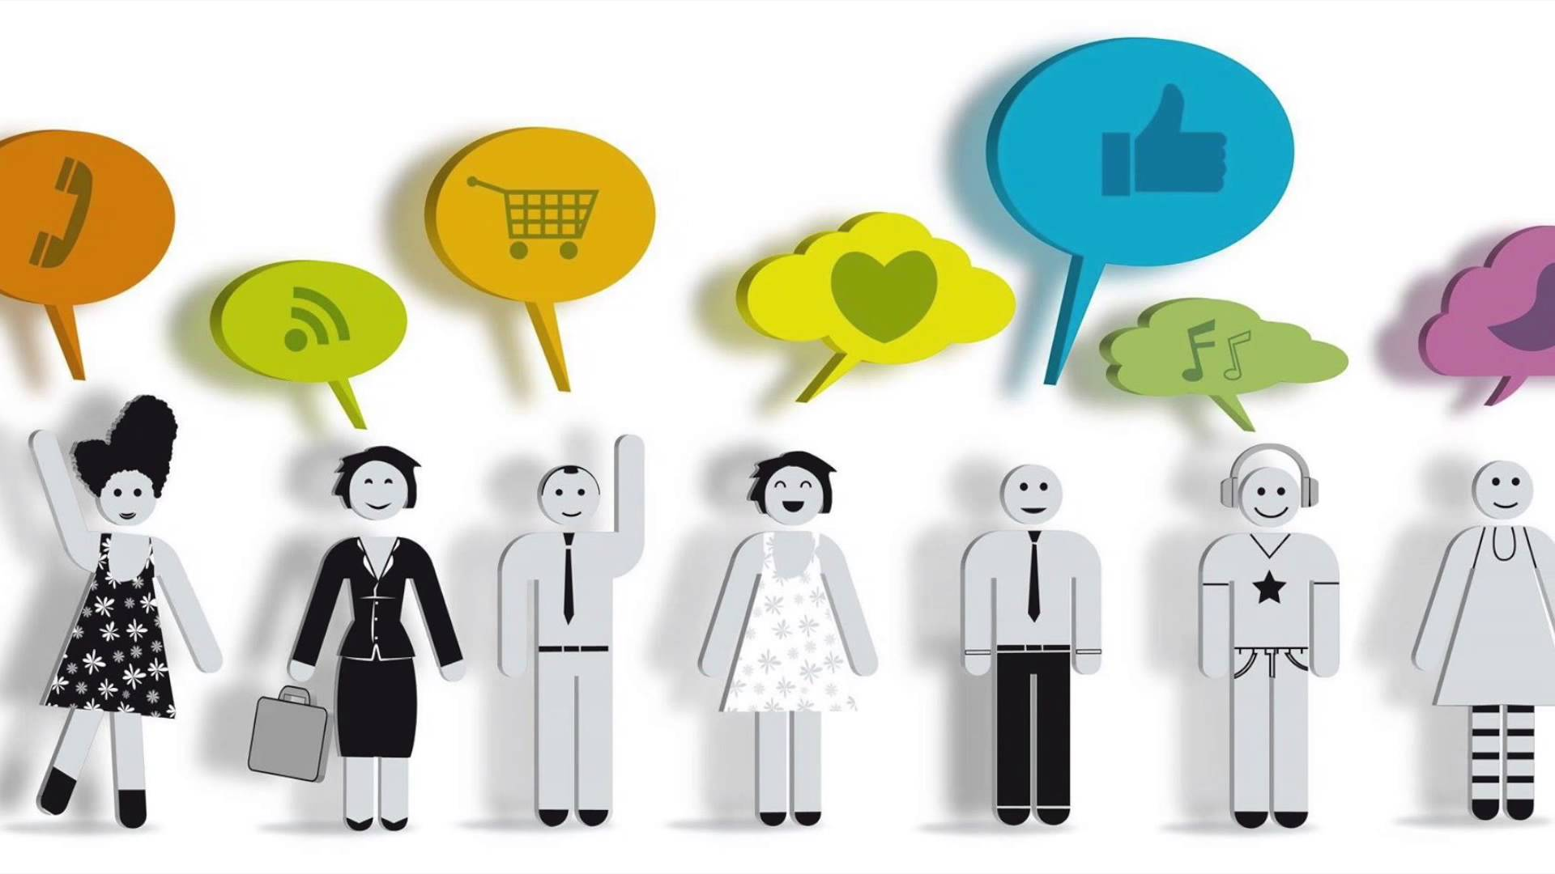
Behavioral Ethics
Draws on behavioral psychology, cognitive science and related fields to determine why people make the ethical decisions that they do, both good and bad.
Much research addresses the question of why good people do bad things.
Notes:
The study of why well-intentioned people sometimes make bad decisions and do not live up to their own ethical standards.

Slide 25

Behavioral Ethics
Notes:
To minute 5:55 (head with flags)
Ok to go to end at 7:10 minutes
-----------------------------
http://www.youtube.com/watch?feature=player_embedded&v=GKaCqd6UDG4
----------------------------------------------
http://ethicsunwrapped.utexas.edu/video/introduction-to-behavioral-ethics/
http://www.youtube.com/watch?v=GKaCqd6UDG4

Slide 26
Behavioral Ethics
How & why people make the ethical/unethical decisions they make
Conformity Bias
Role Morality
Overconfidence Bias
Notes:
Focuses on situational factors which can overwhelm a person’s character
Psychological biases
- Conformity Bias - organizational & social pressures; the tendency people have to take their cues for proper behavior, including ethical behavior, from their peers rather than exercising their own independent ethical judgment
- Role Morality - tendency ppl have to use different moral stds as they play different roles in society, e.g., manager, student. Has been defined as feeling that you have permission to harm others in ways that would be wrong if it weren’t for the role that you are playing. Role morality often involves people acting in ways that they would view as clearly unethical
if they were acting on their own behalf, but because they are acting on behalf of their employer or a client, they view their actions as permissible.
E.g.,
- Overconfidence Bias - tendency of ppl to be more confident than is objectively justified regarding their moral character and ability to act ethically
It’s been argued that most of the principals in corporate scandals (like Enron which we’ll study), were plagued more by BAD DECISION MAKING than by an inability to recognize or analyze ethical dilemmas.
---------------------------------------------------------
Role Morality—which is the tendency many people have to use different moral standards as they play different “roles” in society--‐--‐ for example, to take ethically questionable actions in their role as loyal employees at work to advance their company’s profit goals that they would never take at home to put money in their own pocket.
Overconfidence Bias – which is the tendency of people to be more confident than is objectively justified by their abilities and characteristics, including in their moral character and their ability to act ethically.

Slide 27

Notes:
10 mins
Dan Ariely TED talk on Predictable Irrationality
http://www.ted.com/talks/dan_ariely_on_our_buggy_moral_code

Slide 28
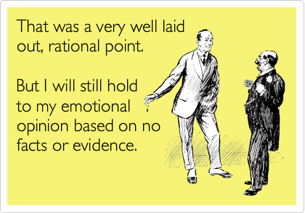
Predictable Irrationality
“moral dumbfounding” – when a strong ethical judgment is reached that cannot be
rationally defended
Notes:
When it seems to people that they are reasoning through to a conclusion regarding what is the moral course of action, often they are simply rationalizing a conclusion that the emotional parts of their brains have already reached.
Only if individuals are aware that their emotional responses may lead them to inaccurate judgments and inappropriate actions can they guard against this widespread tendency.
Thoughtful analysis and decision making is not always second nature to people but it can be practiced and implemented.

Slide 29
“Personal Fudge Factor”
“Essentially, we cheat up to the level that allows us to retain our self-image as reasonably honest individuals.” -- Dan Ariely

Slide 30

Take Aways
Humans do not always act rationally.
Our ethical judgments are more emotion-based than we tend to realize.
Research shows people think of themselves as ethical and yet often lie a little and cheat a little to advantage themselves in ways that are inconsistent with their own mental vision of themselves.
Notes:
One major finding in biz ethics is that most people want to be and do think of themselves as being ethical people, and yet simultaneously often lie a little and cheat a little to advantage themselves in ways that are inconsistent with their mental vision of themselves.

Slide 31
Key Concepts
Ethical Dilemma
Business Case
Business Model
Competitive Advantage
Stakeholder
Shareholder
Stakeholder Theory
Globalization
Corporate Social Responsibility (CSR) / Sustainability
©Cathy Moran, 2018
Notes:
Ethical Dilemma: a situation in which there is a choice to be made between two options, neither of which resolves the situation in an morally acceptable way.
Business Case: The argument for doing something; business case vs. business model: why do it vs how to do it. A business case captures the reasoning for initiating a project or task.
Business Model: A term used to represent core aspects of a business, including purpose, target customers (e.g., consumers or other businesses), product/service offerings, strategies, organizational structures, trading practices, distribution model (e.g., direct sales, wholesale, retail) and operational processes and policies.
Competitive Advantage: The edge a company has over its rivals that allows it to generate greater sales or profit margins or to retain more customers than its competition.
Stakeholder: A person, group, organization, or system who affects or can be affected by an organization's actions
Shareholder: Any person, company or other institution that owns at least one share of a company’s stock. Shareholders are a company's owners. They have the potential to profit if the company does well, but that comes with the potential to lose money if the company does poorly. A shareholder may also be referred to as a stockholder.
Stakeholder Theory: The business entity should be used as a vehicle for coordinating stakeholder interests instead of maximizing shareholder (owner) profit. Stakeholder Theory says the business should consider the interests of all stakeholders and optimize profit with these considerations in mind. Shareholder profit is still very important however it is not the only thing that’s important. Stakeholder Theory is contradictory to Milton Friedman’s thinking that the goal of business must be to maximize profit and that business should not be concerned with anything other than this.
Globalization: The increasingly worldwide relationships of culture, people and economic activity. Most often, it refers to economics: the global distribution of the production of goods and services, through reduction of barriers to international trade such as tariffs, export fees, import quotas, etc.. The term can also refer to the transnational circulation of ideas, languages, and popular culture.
Corporate Social Responsibility / Sustainability: “continuing commitment by business to behave ethically and contribute to economic development while improving the quality of life in the workforce and their families as well as of the local community and society at large” (source: World Business Council on Sustainable Development, http://www.wbcsd.org).

Slide 32

Case Study Preparation
Who are the parties in the story?
Who operated the Bhopal plant? Why didn’t Union Carbide Corporation operate it?
What are the central issues in this case?
When did the tragedy happen?
When was the Bhopal plant built?
Where did this event take place?
Where was the trial held?
Why did the gas leak happen?
How many people were affected by the tragedy?

Slide 33
Before Next Class
Before Next Class
Read (on TritonEd and sent by email)
  1) Syllabus
  2) “Requirements for Papers and Scoring Criteria”
  3) “Debates: Keys to Success, Format, and Evaluation of Performance”
Sign up with the Rady Behavioral Lab
Buy course materials
Read “Union Carbide's Bhopal Plant, Part A”. Do not read Part B before class; bring it to class.
(Harvard Business Publishing Coursepack)
Prepare for Quiz on Thursday, Oct. 11, that includes Union Carbide case study
Volunteer for Debate 2 (optional)
Introductions
©Cathy Moran, 2017

Slide 34

Debate 2: Tuesday, October 23
Team 1 | Team 2
Qualifications to volunteer:
Must be registered in the class (not waitlist)
Must have access to course site on TritonEd
Must have attended all class sessions
Must have taken Quiz 1
Must have submitted Paper 1 on time
  To be considered: send email to mgt166ucsd@gmail.com

Slide 35

  To be considered: email mgt166ucsd@gmail.com
mgt166ucsd@gmail.com
Include your class time in the Subject
2:00 debate volunteer
My name is Rachel Carson. I would like to volunteer for the first debate.
Include your name if it is not clear from your email address.

Slide 36
©Cathy Moran, 2018. Do not copy, post, publish or distribute in any way without permission.
cmoran@ucsd.edu
(760) 822-2741

Slide 37
Study Questions
©Cathy Moran, 2018

Slide 38
Study Questions
What is an ethical dilemma?
What is the difference between and ethical dilemma and a moral temptation?
Describe each of the 4 Dilemma Paradigms.
How do you work through an ethical dilemma to come to a decision?
What is behavioral ethics?
Describe each of the following psychological biases.
  Conformity Bias
  Role Morality
  Overconfidence Bias
What does Dan Ariely mean by “personal fudge factor”?
Write your answers to these questions.
Next, compare your answers to those given in the next slides
©Cathy Moran, 2018

Slide 39
Study Questions
What is an ethical dilemma?
  An ethical dilemma is a situation in which there is a choice to be made between two options, neither of which resolves the situation in a morally acceptable fashion.
  An ethical dilemma is a situation where you must choose between two “rights”. By this, we mean two options, both of which it can be argued are moral.
What is the difference between and ethical dilemma and a moral temptation?
  MORAL TEMPTATION: choosing to do something we know is wrong
  (right vs. wrong)
  ETHICAL DILEMMA: having to choose between two rights (right vs. right)
©Cathy Moran, 2018

Slide 40
Study Questions
Describe each of the 4 Dilemma Paradigms.
  See the last slide for descriptions of each.
How do you work through an ethical dilemma to come to a decision?
  Identify the ethical dilemma and gather facts
  Identify those likely to be affected by the decision
  Identify all viable courses of action, including benefits & risks for each
  Evaluate the pros & cons for each course of action
  Make a decision and test it
  Act and reflect on the outcome
©Cathy Moran, 2018

Slide 41
Study Questions
What is behavioral ethics?
  The study of why well-intentioned people sometimes make bad decisions and do not live up to their own ethical standards.
Describe each of the following:
  Overconfidence Bias: tendency of people to be more confident than is objectively justified regarding their moral character and ability to act ethically
  Conformity Bias: organizational & social pressures; the tendency people have to take their cues for proper behavior, including ethical behavior, from their peers rather than exercising their own independent ethical judgment
  Role Morality: tendency people have to use different moral standards as they play different roles in society, e.g., manager, student. Has been defined as feeling that you have permission to harm others in ways that would be wrong if it weren’t for the role that you are playing. Role morality often involves people acting in ways that they would view as clearly unethical if they were acting on their own behalf, but because they are acting on behalf of their employer or a client, they view their actions as permissible.
©Cathy Moran, 2018

Slide 42
Study Questions
What does Dan Ariely mean by “personal fudge factor”?
  “Essentially, we cheat up to the level that allows us to retain our self-image as reasonably honest individuals.” -- Dan Ariely
  Put another way, we rationalize cheating a little bit. Cheating beyond that point (which is different for different people) causes us to feel bad about ourselves.
©Cathy Moran, 2018

Slide 43
Supporting content

Slide 44
Four Paradigms for Understanding Ethical Dilemmas
Truth vs. Loyalty: Truth, for most people, is conformity with facts or reality. Loyalty involves allegiance to a person, corporation or body of people, a government, or set of ideas to which one owes fidelity. It is right to stand on truth. It is right to be loyal.
Individual vs. Community: Individualism assumes that in a society where each person vigorously pursues his own interests, the social good would automatically emerge. As such, the rights of the individual are to be preserved. By “community” it is meant that the needs of the majority outweigh the interests of the individual. Communities speak to us in a moral voice. They lay claims on their members. It is right to consider the individual. It is right to consider the community.
Short-Term vs. Long-Term: Short-term concerns are usually associated with the satisfaction of current needs in such a way as to preserve the possibility of a future. Long-term concerns are usually defined by the projection of future interests in such a way that there will be ample means to meet future required needs. It is right to think and plan short-term. It is right to think and plan long-term.
Justice vs. Mercy: Justice urges us to stick by our principles, hold to the rules despite the pressures of the moment, and pursue fairness without attention to personalities or situations. Mercy urges us to care for the peculiar needs so individuals case by case and to seek benevolence in every way possible. It is right to be merciful. It is right to enforce justice.
Notes:
How is understanding the type of dilemma helpful?
-It helps us separate right from wrong;
-It helps us cut through mystery, complexity, and confusion;
-it helps us strip away extraneous detail and get to the heart of the matter.

